Slide 1
Experiment – 2
PRN : 25070521165
2.1.1 Roots of a Quadratic Equation
Algorithm
STEP 1 : Start
STEP 2 : Input a, b, c
STEP 3 : Calculate
D = b*b – 4*a*c
STEP 4 : if D > 0
root1 = (-b+√D)/(2*a)
root2 = (-b-√D)/(2*a)
else if D==0
root1 = root2 = (-b)/(2*a)
else
real = (-b)/(2*a)
imaginary = (√-D)/(2*a)
root1 = real + imaginary
root2 = real - imaginary
STEP 5 : Print root1, root2

Slide 2
Flowchart
PRN : 25070521165
Start
Input a, b, c
D = b*b-(4*a*c)
Yes
If d > 0
No
Yes
Else if d = 0
No
root1 = (-b + √ D)/(2*a)
root2 = (-b - √D)/(2*a)
real = -b/(2*a)
img = √- D/(2*a)
root1 = (-b)/(2*a)
root2 = (-b)/(2*a)
root1 = real + img
root2 = real - img
Print root1, root2
Stop

Slide 3
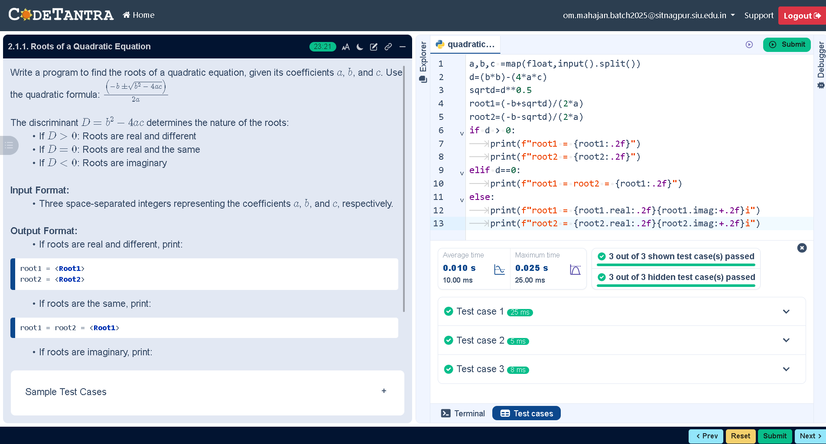
Code
PRN : 25070521165
a,b,c =map(float,input().split())
d=(b*b)-(4*a*c)
sqrtd=d**0.5
root1=(-b+sqrtd)/(2*a)
root2=(-b-sqrtd)/(2*a)
if d > 0:
print(f"root1 = {root1:.2f}")
print(f"root2 = {root2:.2f}")
elif d==0:
print(f"root1 = root2 = {root1:.2f}")
else:
print(f"root1 = {root1.real:.2f}{root1.imag:+.2f}i")
print(f"root2 = {root2.real:.2f}{root2.imag:+.2f}i")
Execution

